Slide 1
Inclusion and Exclusion Criteria
All 160.X + Any ENT Code*: - 14424 Admissions
160.X Primary Diagnosis - 6661 Admissions
(avoids chemo, rad, or complication visits)
Surgical Primary Procedure- 3850 Admissions
Includes codes that relate to surgery to eye or brain
Orbit Or Maxillo Involvement
Neck Dissection
Ethmoid or Neurosurg Codes

Slide 2
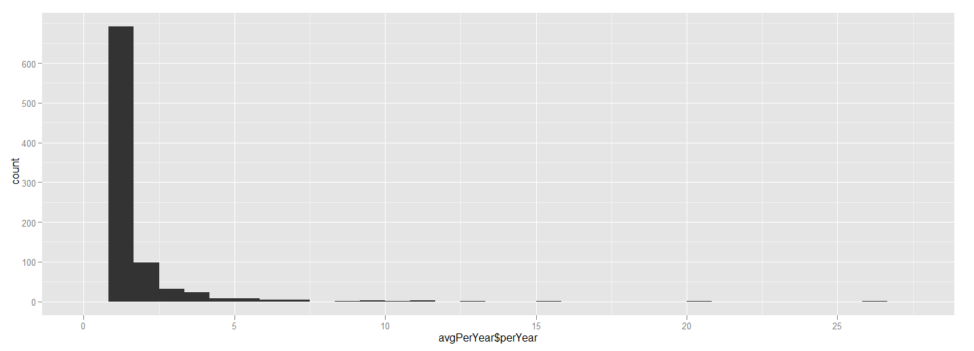
In most stringent inclusion/exclusion criteria:
 | Criteria | Num of Adm | Num Hospitals
High | >= 5/year | 1097 | 32
Medium | 1 – 5/year | 1939 | 303
Low | 1/year | 814 | 879

Slide 3
General Statistics
 | Criteria | Num of Adm | Num Hospitals | Num Deaths (%) | Other Complications (%)
High | >= 5/year | 1097 | 32 | 4 (0.36%) | 183 (16.7%)
Medium | 1 – 5/year | 1939 | 303 | 11 (0.57%) | 287 (14.8%)
Low | 1/year | 814 | 879 | 15 (1.84%) | 102 (12.5%)

Slide 4
Subsets
Subset | Number | Complications | Deaths | High | Med | Low
Total | 3850 | 572 (14.9%) | 30 (0.8%) | 1097 (28.5%) | 1939 | 814
Neck Dissection | 244 | 42 (17.2%) | 3 (1.2%) | 79 (32.4%) | 125 | 40
Orbit/Max Involv | 236 | 61(25.8%) | 3 (1.3%) | 106 (44.9%) | 113 | 17
Neurosurg | 558 | 151(27.1%) | 5 (0.9%) | 255(45.7%) | 251 | 52

Slide 5
Orbit Or Maxillo Involvement
1652 = "1652: ORBIT EXENT W BONE REMOV“
1692 = "1692: EXCISION ORBITAL LESION«
1651 = "1651: RADICAL ORBITOMAXILLECT“
2231 = "2231: RADICAL MAXILLARY ANTROT"
2262 = "2262: EXC MAX SINUS LESION NEC“
1609 = "1609: ORBITOTOMY NEC“
1602 = "1602: ORBITOTOMY W IMPLANT“
2239 = "2239: EXT MAXILLARY ANTROT NEC"
Neck Dissection
4040 = "4040: RAD NECK DISSECTION NOS“
4041 = "4041: UNILAT RAD NECK DISSECT”
4042 = "4042: BILAT RAD NECK DISSECT"
Neurosurgery Codes
2263 = "2263: ETHMOIDECTOMY“
0159 = "0159: OTHER BRAIN EXCISION“
0206 = "0206: CRANIAL OSTEOPLASTY NEC" 0151 = "0151: EX CEREB MENINGEAL LES"
0442 = "0442: CRAN NERV ROOT DECOM NEC"
0118 = "0118: OTHER BRAIN DX PROCEDURE”
0203 = "0203: SKULL FLAP FORMATION”
0124 = "0124: OTHER CRANIOTOMY“
0153 = "0153: BRAIN LOBECTOMY“
0131 = "0131: INCISE CEREBRAL MENINGES“
0139 = "0139: OTHER BRAIN INCISION"
0204 = "0204: BONE GRAFT TO SKULL“
0202 = "0202: ELEVATE SKULL FX FRAGMNT"
0212 = "0212: BRAIN MENINGE REPAIR NEC"

Slide 6
Death ~ Hospital Volume + Age + Payer (Insurance) + Year (1988 – 2009) + Primary Diagnosis
More Mortality If Older, Early in Database, or Ddx of malignant neoplasm of other accessory sinuses
Coefficients:
Estimate Std. Error t value Pr(>|t|)
(Intercept) 1.5765880 0.8854824 1.780 0.0751 .
factor(data$volume)low 0.0125796 0.0082789 1.519 0.1287
factor(data$volume)medium 0.0011219 0.0067400 0.166 0.8678
data$age 0.0005576 0.0001843 3.025 0.0025 **
data$pay1 0.0008425 0.0021427 0.393 0.6942
data$year -0.0008059 0.0004429 -1.820 0.0689 .
factor(data$d1)1602 -0.0002452 0.0068677 -0.036 0.9715
factor(data$d1)1603 0.0032854 0.0098885 0.332 0.7397
factor(data$d1)1604 -0.0022006 0.0219945 -0.100 0.9203
factor(data$d1)1605 0.0032103 0.0158178 0.203 0.8392
factor(data$d1)1608 0.0186135 0.0098674 1.886 0.0593 .
factor(data$d1)1609 -0.0005938 0.0212240 -0.028 0.9777

Slide 7
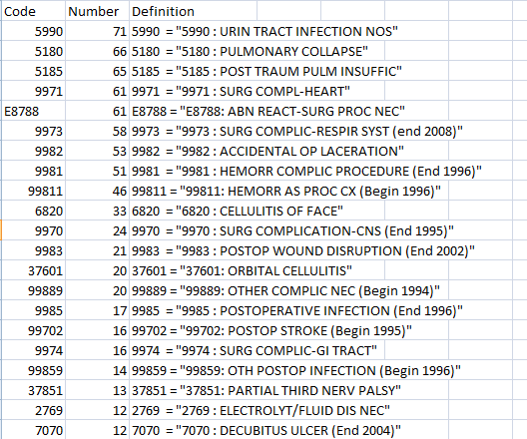
Complications (n = 602, 15.6%)
Currently just looking at these complications, I have attached full list of events, let me know if there are complications I should add.

Slide 8
Complication (Including Death) ~ Hospital Volume + Age + Payer + Year + Primary Diagnosis
More Complications If Older Patient Or
1602 = "1602 : MAL NEO MAXILLARY SINUS“ 1608 = "1608 : MAL NEO ACCESS SINUS NEC"
Estimate Std. Error t value Pr(>|t|)
(Intercept) 1.6919554 1.8221686 0.929 0.353186
relevel(factor(data$volume), "high")low -0.0270261 0.0170366 -1.586 0.112741
relevel(factor(data$volume), "high")medium -0.0173139 0.0138697 -1.248 0.211988
data$age 0.0009207 0.0003793 2.427 0.015265 *
data$pay1 -0.0005962 0.0044093 -0.135 0.892458
data$year -0.0008024 0.0009114 -0.880 0.378651
factor(data$d1)1602 0.0371594 0.0141326 2.629 0.008589 **
factor(data$d1)1603 0.0321207 0.0203489 1.579 0.114533
factor(data$d1)1604 0.0384775 0.0452608 0.850 0.395307
factor(data$d1)1605 0.0037132 0.0325503 0.114 0.909183
factor(data$d1)1608 0.0713670 0.0203054 3.515 0.000445 ***
factor(data$d1)1609 -0.0007226 0.0436752 -0.017 0.986800

Slide 9
Complication (Including Death) ~ Hospital Volume + Age + Payer + Year + Primary Procedure
Procedures associated with more complications include:
1651 = "1651: RADICAL ORBITOMAXILLECT“ 1652 = "1652: ORBIT EXENT W BONE REMOV" 1692 = "1692: EXCISION ORBITAL LESION" 2122 = "2122: NASAL BIOPSY" 2211 = "2211: (CLOSED) NASAL SINUS BX (Begin 1988)" 2231 = "2231: RADICAL MAXILLARY ANTROT" 2242 = "2242: FRONTAL SINUSECTOMY" 2252 = "2252: SPHENOIDOTOMY“ 2260 = "2260: SINUSECTOMY NOS" 2261 = "2261: C-LUC EXC MAX SINUS LES" 2262 = "2262: EXC MAX SINUS LESION NEC" 2263 = "2263: ETHMOIDECTOMY" 2264 = "2264: SPHENOIDECTOMY" 2721 = "2721: BONY PALATE BIOPSY" 4041 = "4041: UNILAT RAD NECK DISSECT" 7639 = "7639: PART FACIAL OSTECTOM NEC“ 7644 = "7644: TOT FACE OSTECT W RECONS"
Bolded Procedures had the most statistical power for association with complications

Slide 10
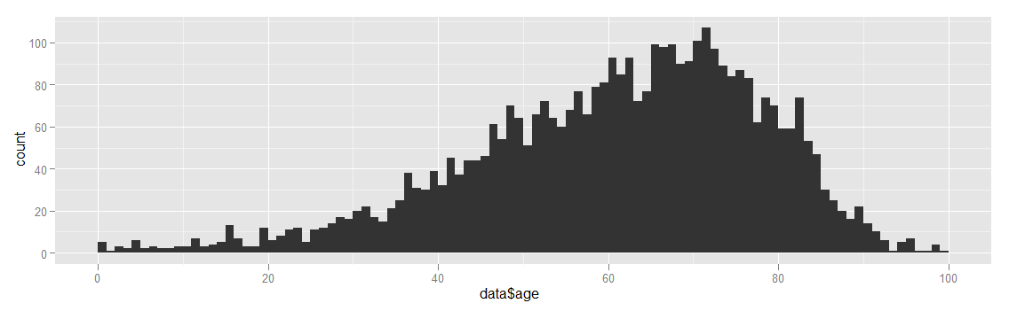
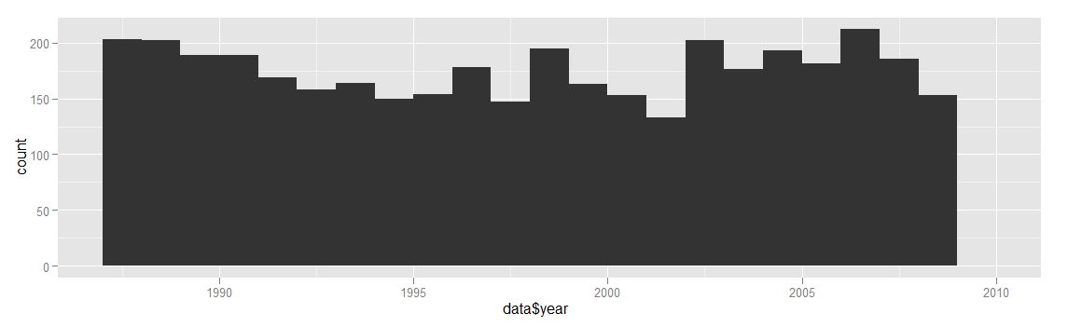
General Summary Statistics
40% Male

Slide 11
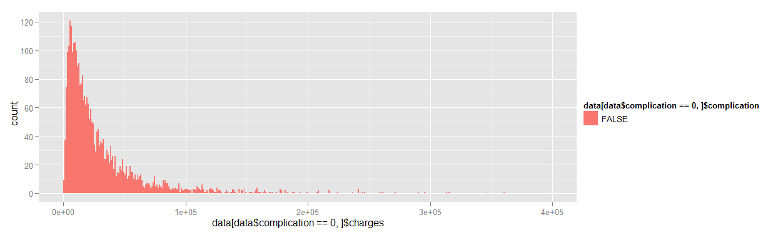
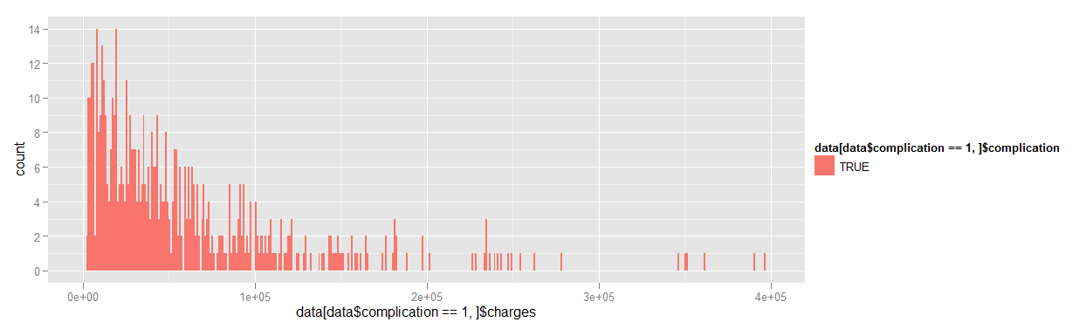
Approximately Similar Cost w/wout Compications
Costs for Patients without Complications
Costs for Patients with Complications

Slide 12
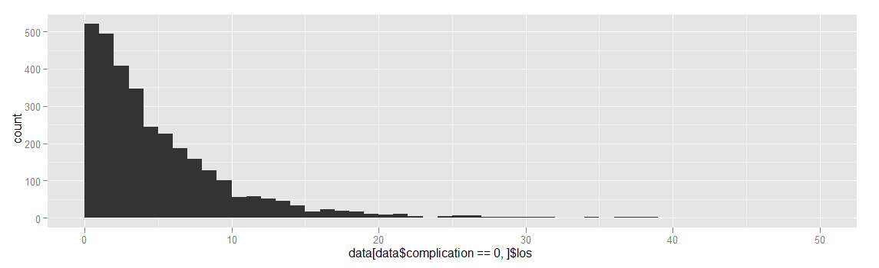
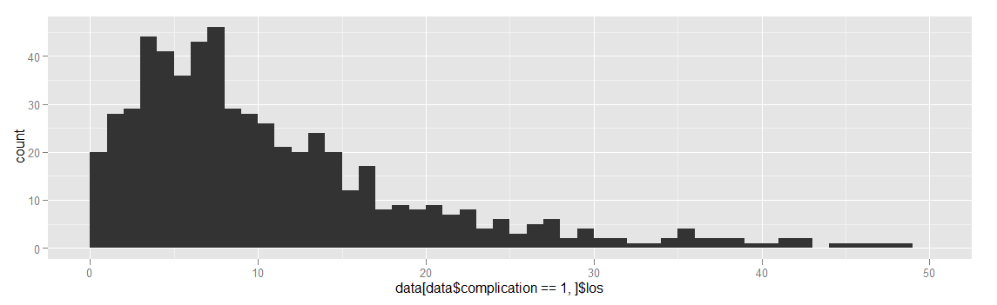
Patients with Complications have Longer Lengths of Stays
Length of Stay for Patients without Complications
Mean = 5.68
Length of Stay for Patients with Complications
Mean = 12.62

